Slide 1

Content Delivery and the Natural Evolution of DNS
Remote DNS Trends, Performance Issues and Alternative Solutions
John S. Otto
Mario A. Sánchez
John P. Rula
Fabián E. Bustamante
Northwestern, EECS
Notes:
20’ for talk, 4’ for Q&A

Slide 2
Domain Name System evolution
DNS designed to map names to addresses
  Evolved into a large-scale distributed system
CDNs leverage DNS for dynamic routing
  Assume proximity between users and their resolvers
Use of remote DNS
  Servers concentrated farther from users
  Susceptible to configuration errors (e.g. Comcast DNS outages)
Growing alternative third-party DNS services
  Public DNS usage has grown to 11% of users!
So what?

Slide 3

Ubiquity of Content Delivery Networks
Visit cnn.com…
34 DNS lookups
204 HTTP requests
520 KB of data downloaded

Slide 4

















Ubiquity of Content Delivery Networks
56% of domains resolve to a CDN

Slide 5
Ubiquity of Content Delivery Networks
It’s not just cnn.com…
74% of the top 1000 web sites use CDNs

Slide 6
CDNs depend on user’s DNS to direct requests
We see 27% annual increase in their usage
Remote DNS services break this assumption

Slide 7
Roadmap
The cost of remote DNS
The industry response
An end-host-based solution

Slide 8
The numbers
An experiment in Dasu – a BitTorrent-based platform for network characterization and experimentation
  Subset of clients: 10,923 hosts, 99 countries, 752 ISPs
Measure DNS servers
  ISP servers and public DNS services
  Network and application level probes
Obtain CDN redirections for each DNS service
  Download small web objects hosted by several CDNs
  Do iterative resolution for baseline
  In this talk… Google DNS and Akamai CDN as examples
End-to-End Latency
DNS Latency
HTTP Latency
Send DNS query
Get DNS answ
HTTP connect
Received 1st byte of object

Slide 9
Evaluating CDN redirections
Multiple redirections show typical set of servers
  Depends on DNS location, CDN load balancing, network conditions
Compare overlap of servers between locations

Slide 10
Impact of remote DNS on CDN redirections
Remote DNS services yield radically different redirections
  Minimal overlap with those seen from the client
Different redirections, but does it affect performance?
A good approximation
80% median overlap
90% have
no overlap
Better overlap
Redirections via client are consistent

Slide 11
Impact of remote DNS on CDN performance
Different redirections mean different performance
Better performance
80% have <15% penalty
Top 20% have 200% penalty
In median case, 65% penalty

Slide 12
Roadmap
The cost of remote DNS
  Yields different CDN redirections to 90% of users
  Increasing end-to-end web latency by 65% for median user
The industry response
An end-host-based solution

Slide 13
DNS extension approach
Idea: avoid impact of remote DNS by changing localization approach – directly provide client location to CDN
Implemented as an EDNS0 extension “edns-client-subnet”
DNS resolver adds client’s IP prefix to request
CDN redirection based on client’s location, not resolver’s
First evaluation of EDNS effectiveness
Approximate client location approach typically sufficient
  /16 prefix enough for Google and EdgeCast CDNs

Slide 14
Evaluating the DNS extension approach
Focus on places where remote DNS affects performance
45% performance improvement

Slide 15
DNS extension adoption
Minor issue – both DNS and CDN services must support it
Google service support
most sites don’t support it
Only 1% of sites use it for content
Most support seen for Google services
Should we just wait?
5-10 public DNS
100’s of ISPs
50+ CDNs

Slide 16
Roadmap
The cost of remote DNS
  Yields different CDN redirections to 90% of users
  Increasing end-to-end web latency by 65% for median user
The industry response – edns-client-subnet
  First evaluation of its effectiveness
  Median user could get 45% performance improvement
  Nearly 2 years since proposed; 1% of sites support it
An end-host-based solution

Slide 17
End host solution – namehelp
Different approach: move the resolver close to the user
End host directly queries for CDN redirection
  CDN redirection based on client’s location
Run a DNS proxy on the user’s machine
Monitor stream of requests to identify CDN redirections
Use Direct Resolution to improve redirection quality

Slide 18
Direct Resolution approach
Step 1: typical DNS query to recursive resolver
  Use recursive DNS to translate customer name to CDN
Step 2: directly query CDN for an improved redirection
DR
map
2
1
Initial
map

Slide 19
Evaluating solutions
Focus on places where remote DNS affects performance
Available now – works with all CDNs and DNS services
Within 16%
of potential
Improves performance in 76% of locations

Slide 20
Summary
The cost of remote DNS
  Gives different CDN redirections to 90% of users
  Increases end-to-end web latency by 65% for median user
The industry response – edns-client-subnet
  First evaluation of its effectiveness
  Median user could get 45% performance improvement
  Nearly 2 years since proposed; 1% of sites support it
An end-host-based solution
  40% improvement for median user
  Gives better performance in 76% of affected locations
  Readily available
  …

Slide 21

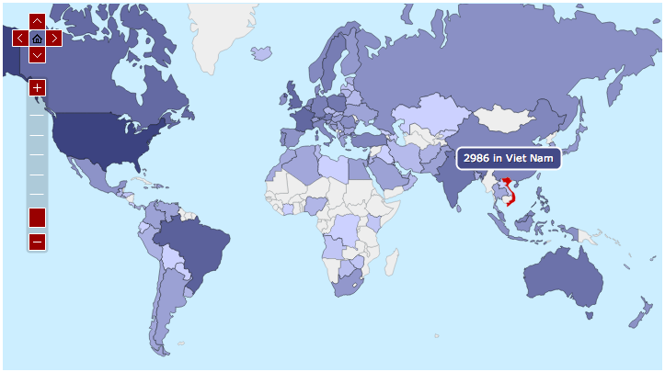
namehelp
… more than just better CDN performance
  Faster lookups with proactive caching
  Automatic, personalized server selection
  Graceful handling of DNS outages …
First 23 days
13,800 users
125 countries
Get it today!
  http://aqualab.cs.northwestern.edu/projects/namehelp

